Slide 1

Software design and architectural style
Teacher: Huang wu
2019/9/3 Chengdu

Slide 2

Teacher introduction
Teacher: Huangwu
Research: Embedded system, medical intellective instrument
Teaching: Courses about software engineering, for example:
software architecture,
software development tool and environment,
software construction
共 45 页

Slide 3

Assistant information
郭赛赛
Email: 18380465404 @163.com
Telephone： 18380465404
QQ group： 757621485
共 45 页

Slide 4
Outline
Some problems
Course arrangement
software architecture in the software engineering
How do you become architect
共 45 页

Slide 5

1. Some problems
Do you know what software design is? Talk about your understand.
共 45 页

Slide 6
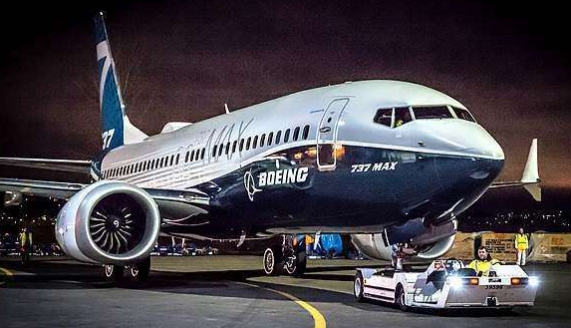

1. Some problems
Why does the Boeing 737 Max crashed?
共 45 页

Slide 7


1. Some problems
How does your company achieve success if you established a company？
共 45 页

Slide 8


1. Some problems
How do you make a good product?
What is important about a product? creative or quality?
共 45 页

Slide 9


1. Some problems
How do your make a good software？
共 45 页

Slide 10
1.1 Development example
Extended Analysis Function
switch ( iAnalysis_Type ) {
case DIFFERENTIAL:
Do_Dif();
break;
case INTEGRAL:
Do_Int();
break;
…
}
How do you add a new analysis function?
CAnalysis
+main() +Do_Dif( numbers : int [ ] ) +Do_Int( numbers : int [ ] )
共 45 页

Slide 11
1.1.1 One method
Modify the main project
switch ( iAnalysis_Type ) {
case DIFFERENTIAL:
Do_Dif();
break;
case INTEGRAL:
Do_Dif();
break;
case FILTER:
Do_Filter();
break;
…
}
CAnalysis
+main() +Do_Dif( numbers : int [ ] ) +Do_Int( numbers : int [ ] ) +Do_Filter( number: int [ ] )
共 45 页

Slide 12
1.1.2 Another method
Add a new class（Low coupling）
CAnalysisAlgorithm
Client
CAnalysisAlgorithm m_Analysis
+Do_Dif( numbers : int [ ] ) +Do_Int( numbers : int [ ] ) +Do_Filter( numbers : int [ ] )
…
+main()
共 45 页

Slide 13
1.1.3 Further Improving
Strategic pattern
Client
《Interface》 CAnalysisAlgorithm
+main()
+Analysis()
Differential
Integral
Filter
FFT
+Analysis()
+Analysis()
+Analysis()
+Analysis()
共 45 页

Slide 14
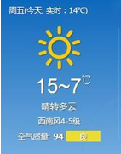
1.2 Another example
Get internet service, such as getting weather
Get_Weather ( www.weather.com\)
How do you do if the www.weather.com is wrong?
Could you get the weather information from non pointed web site?
共 45 页

Slide 15

1.2.1 Flexible interoperation
SOA architecture
UDDI
Universal description discovery integration
Description service
WSDL
1）Discover service
Web Service
Client
Web Service
SOAP protocol
2）Call service
共 45 页

Slide 16
2. Course arrangement
Purpose
How do you study
Course arrangement
Reference book
Score
共 45 页

Slide 17
2.1 Purpose
Design good software ( high quality )
Understand and master the knowledge of designing a good software, for example, quality attributes and tactics, software pattern and style, designing and evaluating the software architecture
Study how can we take advantage of the knowledge in practice
共 45 页

Slide 18
2.2 How do you study
First, good studying attitude
Second, master the most important theories, including quality attributes and tactics, architectural pattern etc.
Then, apply the theory to practice by discussion and program
共 45 页

Slide 19
2.3 Course arrangement
Teaching times：16
Teaching form：Teacher mainly teaches, student discuss
Project：Design a web travel booking system(Hotel Reservation System), similar to the elong or ctrip.
How do you realize the modifiability, security?
共 45 页

Slide 20
2.3 Course arrangement
First: Course introduction
Introduce the aim, scope and other basic knowledge of this course
Some problem
Course arrangement
Software design in software engineering
共 45 页

Slide 21
2.3 Course arrangement
Second: What is Software Architecture
Introduce the concept of software architecture and some ideas about good architecture. Describe three architecture structures:
Module
Component-and-connector
Allocation
共 45 页

Slide 22
2.3 Course arrangement
Third: The relationship between architecture and environment
Introduce the technical, project, business and professional context of architecture.
Introduce the concept of architecture influence cycle(AIC)
共 45 页

Slide 23
2.3 Course arrangement
Fourth: Understanding Quality Attributes
Introduce the concepts of quality attributes and quality attributes scenarios, explain the relationship between quality attributes and the architecture
共 45 页

Slide 24
2.3 Course arrangement
Fifth: Availability quality attributes and tactics
Introduce the concept of quality attribute – availability, and it’s quality attributes scenarios, introduce the detailed tactics for realizing the quality attribute — availability.
共 45 页

Slide 25
2.3 Course arrangement
Sixth: Modifiability & Performance quality attributes and tactics
Introduce the concept of quality attribute – modifiability and performance, and it’s quality attributes scenarios, introduce the detailed tactics for realizing the quality attribute.
共 45 页

Slide 26
2.3 Course arrangement
Seventh: Usability and other quality attributes and tactics
Introduce the concept of quality attribute – usability ,and it’s quality attributes scenarios, introduce the detailed tactics for realizing the quality attribute — usability. Introduce some other quality attributes, such as mobility, conceptual integrity of the architecture etc.
共 45 页

Slide 27
2.3 Course arrangement
Eighth: Midterm exam and Patterns
The first: Midterm exam(60min)
The second: Introduce the patterns
The concept of architectural patterns
Relationships between tactics and patterns
共 45 页

Slide 28
2.3 Course arrangement
Ninth: Architecture example and discussion
Air traffic controller system
Discuss the same system based on different architecture
共 45 页

Slide 29
2.3 Course arrangement
Tenth, Eleventh: Concrete architectural patterns ( Style )
Broker pattern
Layer pattern
Model-View-Controller pattern
Pipe-and-Filter pattern
Peer-to-Peer pattern
Service-Oriented architecture pattern
Publish-Subscribe pattern
Map-Reduce architectural pattern
共 45 页

Slide 30
2.3 Course arrangement
Twelfth: Architecture designing and documenting
Introduce the attribute-driven design (ADD) method. Describe the step of ADD method
Introduce documenting software architecture, and then describe the document view, interface and the organization of documents.
共 45 页

Slide 31
2.3 Course arrangement
Thirteenth: architectural evaluation
Introduce two architecture evaluation methods: the architectural tradeoff analysis method (ATAM), the cost benefit analysis method (CBAM).
ATAM method
CBAM method
共 45 页

Slide 32
2.3 Course arrangement
Fourteenth、Fifteenth: Concrete design patterns
Introduce some concrete design patterns: factory pattern and singleton pattern, composite pattern, adapter pattern, façade pattern and bridge pattern. iterator pattern, visitor pattern and command pattern.
共 45 页

Slide 33
2.3 Course arrangement
Sixteenth: Architectural application (product line) and review
Introduce the concept of product line and application.
Answer question
共 45 页

Slide 34
2.3 Course view
Product line
Interaction
Dependent on
Context
Software architecture
Evaluation
Create architecture
Software design
Document
Base on
Quality attributes
Architectural pattern
(style)
Design pattern
Include
Scenarios
Tactics
Compose
共 45 页

Slide 35

2.4 Reference book
Teaching book
Software architecture in practice.3e, by Bass.Len, Clements. Paul and Kazman.Rick
Tsinghua university press, 2013.2
ISBN: 978-7-302-31293-2.
Price: 79￥
共 45 页

Slide 36
2.4 Reference book
Software architecture in practice.2e Len.Bass, Clements. 清华大学出版社
软件设计与体系结构. 齐志昌. 高等教育出版社. 2010.2. ISBN: 978-7-040-28408-9
软件体系结构. Mary.Shaw, David.Garlan. 清华大学出版社. 2007.9. ISBN: 978-7-302-14550-9
设计模式. Erich.Gamma, Richard Helm. 机械工业出版社. 2007.4. ISBN: 987-7-111-07575-2
共 45 页

Slide 37
2.5 Score
No | Item | Percent | Explain
1 | Peacetime quiz | 20% | 5 times testing
2 | Assignments | 10% | 10 times homework
3 | Project | 10% | Document of the architecture
4 | Mid-term exam | 10%
5 | Discussion | 10% | Classroom lecture
6 | Final exam | 40% | Open book examination
共 45 页

Slide 38
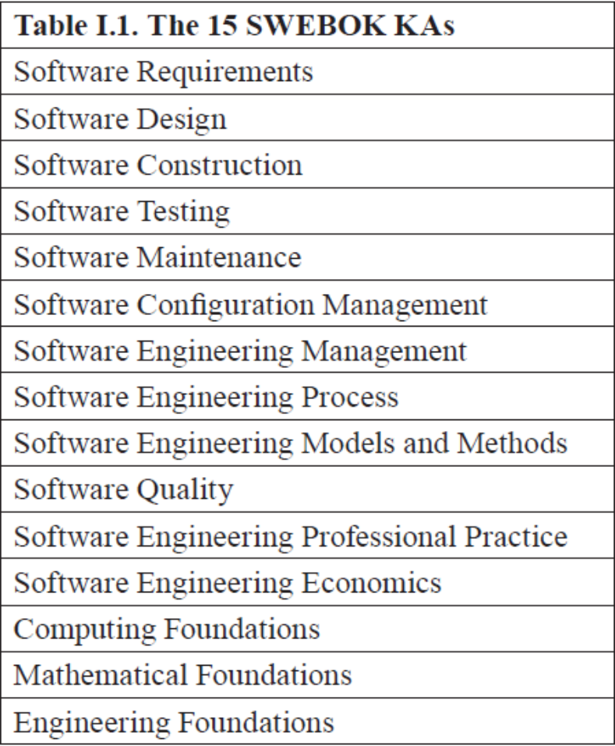
3. Architecture in the software engineering
SWEBOK V3.0
Guide to the software engineering body of knowledge
IEEE 2014
共 45 页

Slide 39
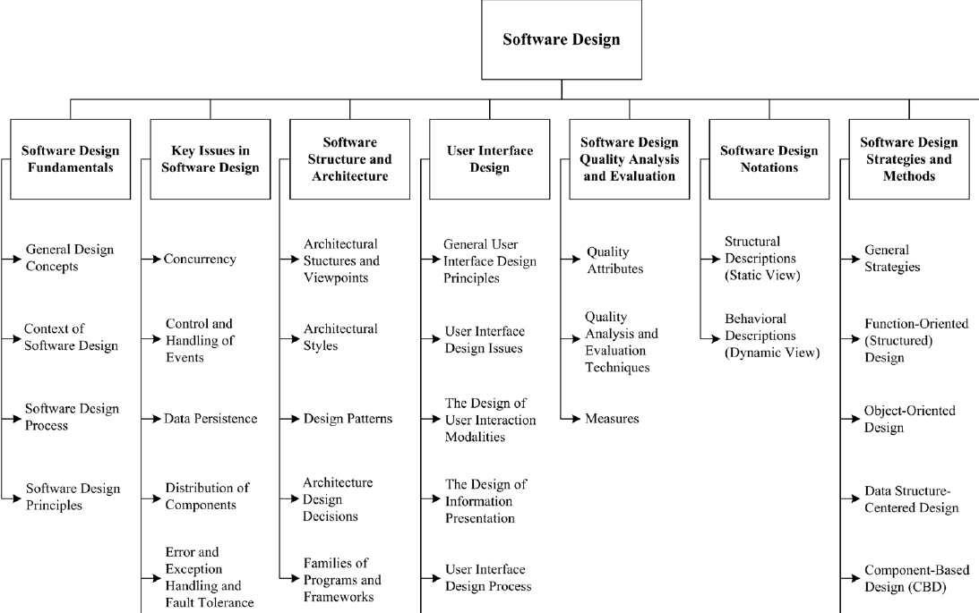
共 45 页

Slide 40
4. How to become a architect
You can’t become a architect only study theory
  Seed: practical programmer
  Sapling: mastered the theory, experience of team development and software management
  Architect: chance, endeavor and talent
    Technique is mastering and overall
    Training the comprehensive ability
    Chance
共 45 页

Slide 41
4.1 Career develop of software engineer
How can you become the expert?
  Enrich your experience
  Develop your technique and the skill of leadership and communication
  Study the architecture
Junior engineer
Senior engineer
Team leader
Engineer
Architect
Improve responsibility, range and challenge
共 45 页

Slide 42

Summary
Why do we study the architecture designing
Course arrangement
software architecture in the software engineering
How do you become architect
共 45 页

Slide 43
Homework
Write a short paper about the software architecture in your view. (about 500 words, you can use chinese language)
You can collect materials from the internet, then you must analyze the materials and summary to become your knowledge
共 45 页

Slide 44
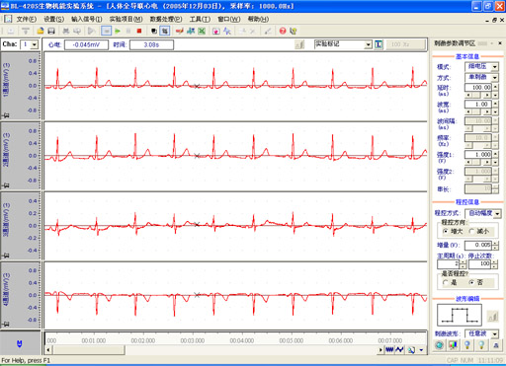
5.1 Data acquisition and analysis system
共 45 页

Slide 45
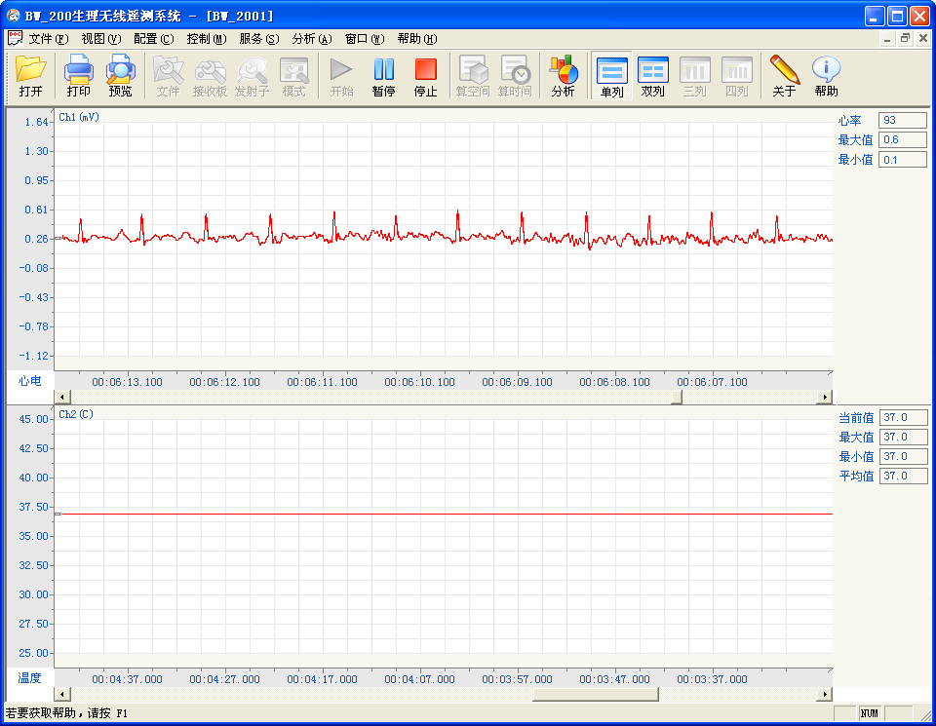
5.2 Physiological wireless signal acquisition system
共 45 页

Slide 46
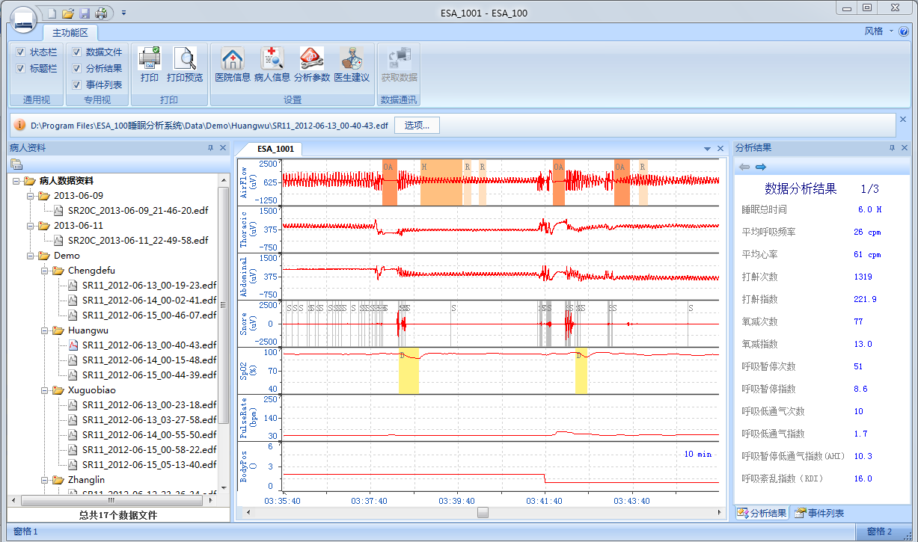
5.3 Sleep analysis system
共 45 页

Slide 47
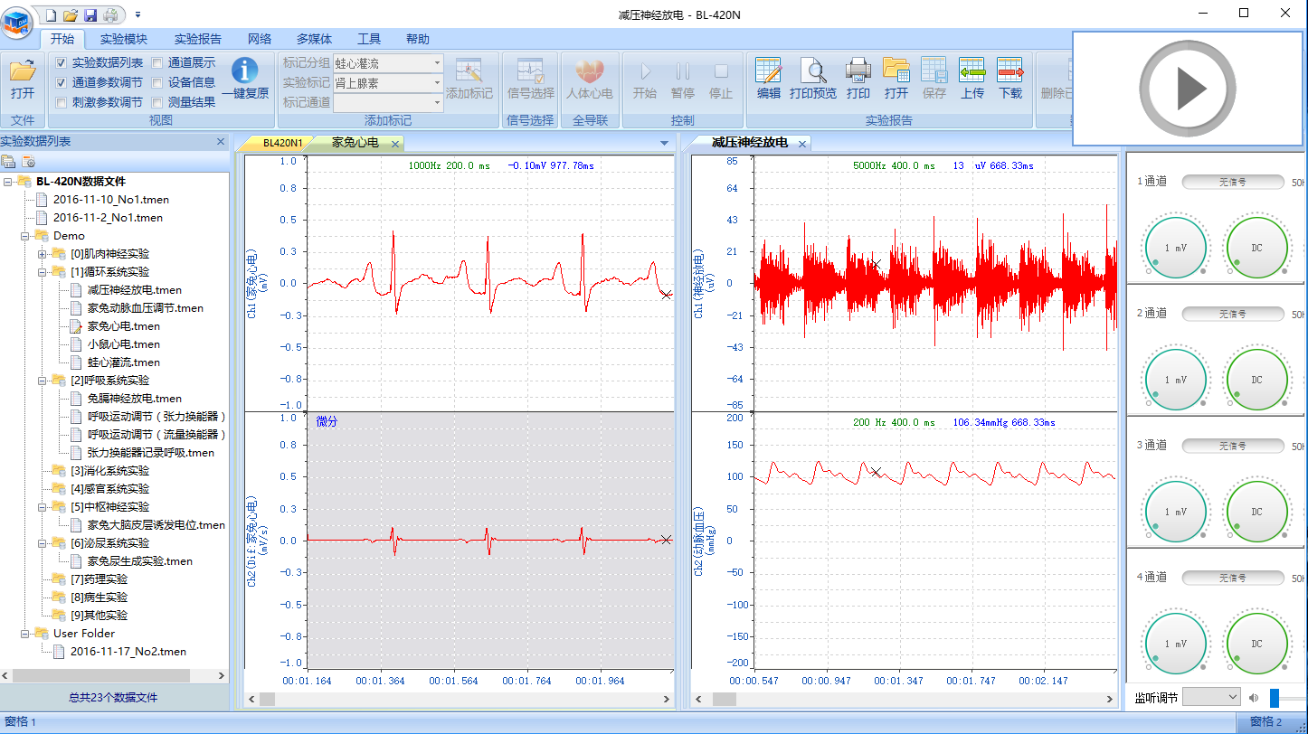
5.4 New data acquisition and analysis system
共 45 页

